Slide 1


Digital marketing & GRAPHIC DESIGNING
  We're an award-winning Digital Marketing Services & Social Media agency and Graphic Designing in New Delhi India. We offer 360°digital solutions that Graphic Designing in Noida enrich your online presence. Graphic Designing in India Social Media Services Let's Chat.

Slide 2
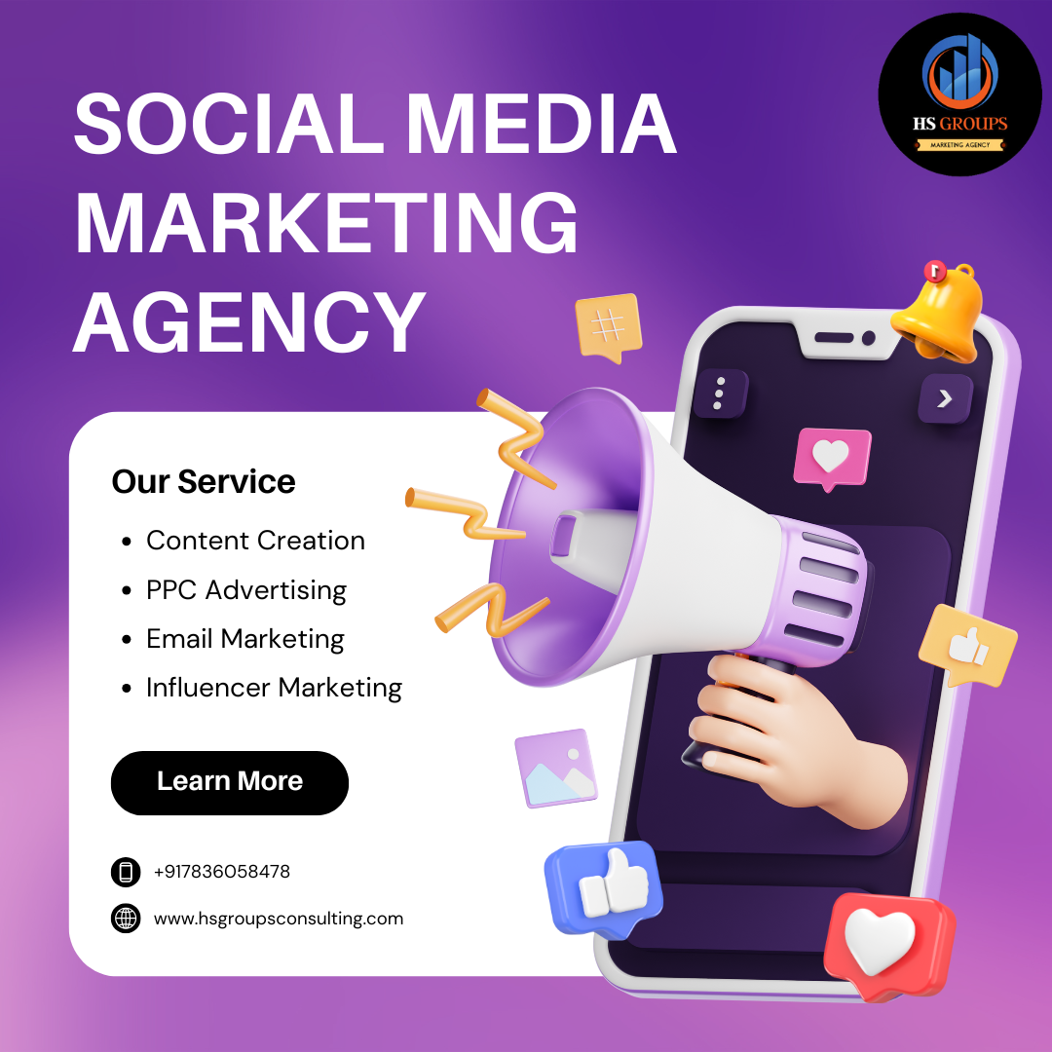
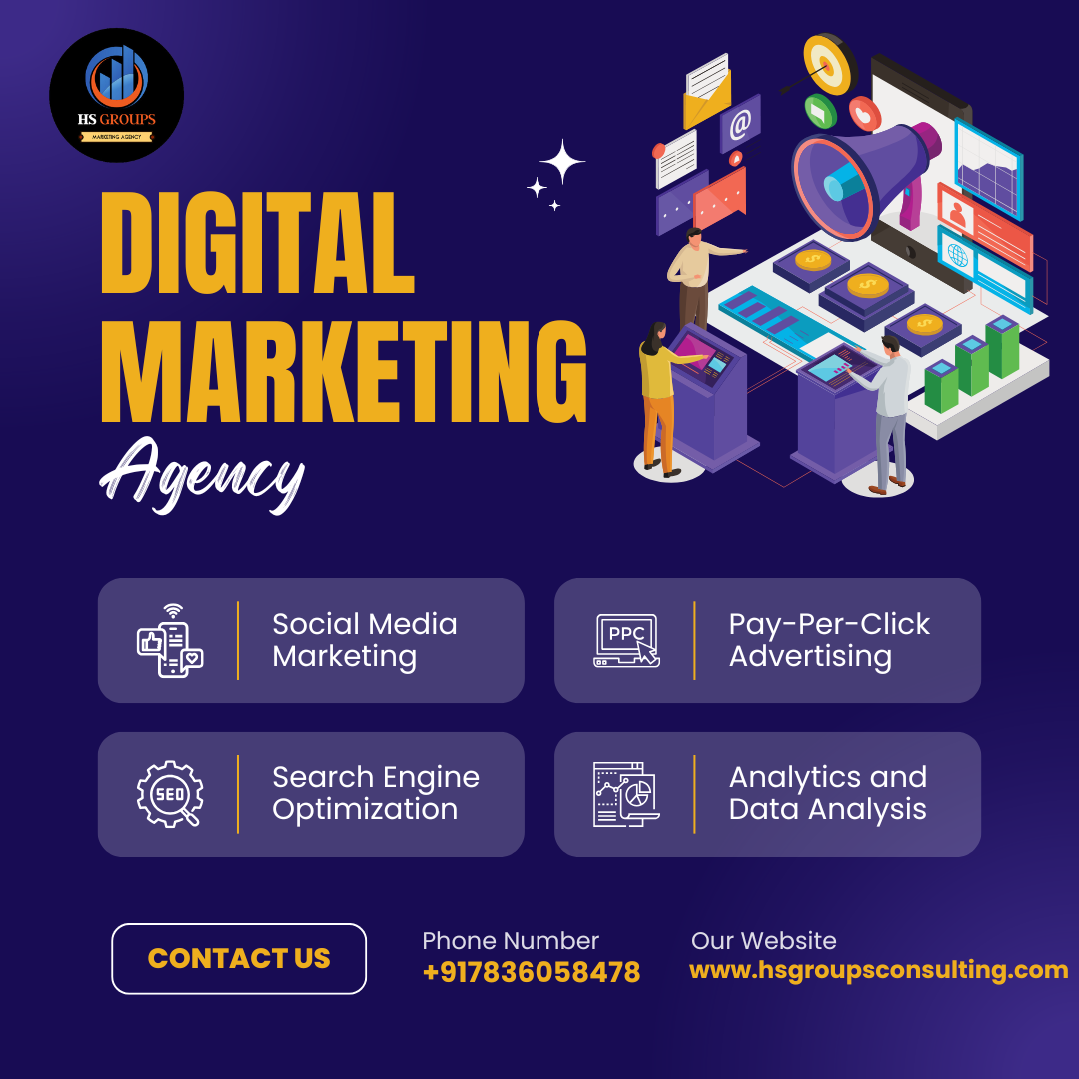
Social Media Post

Slide 3



Slide 4
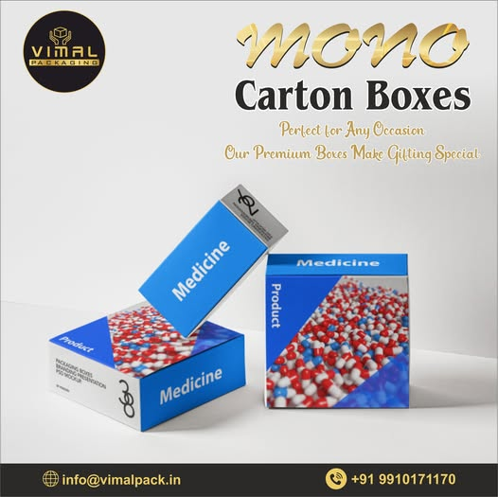
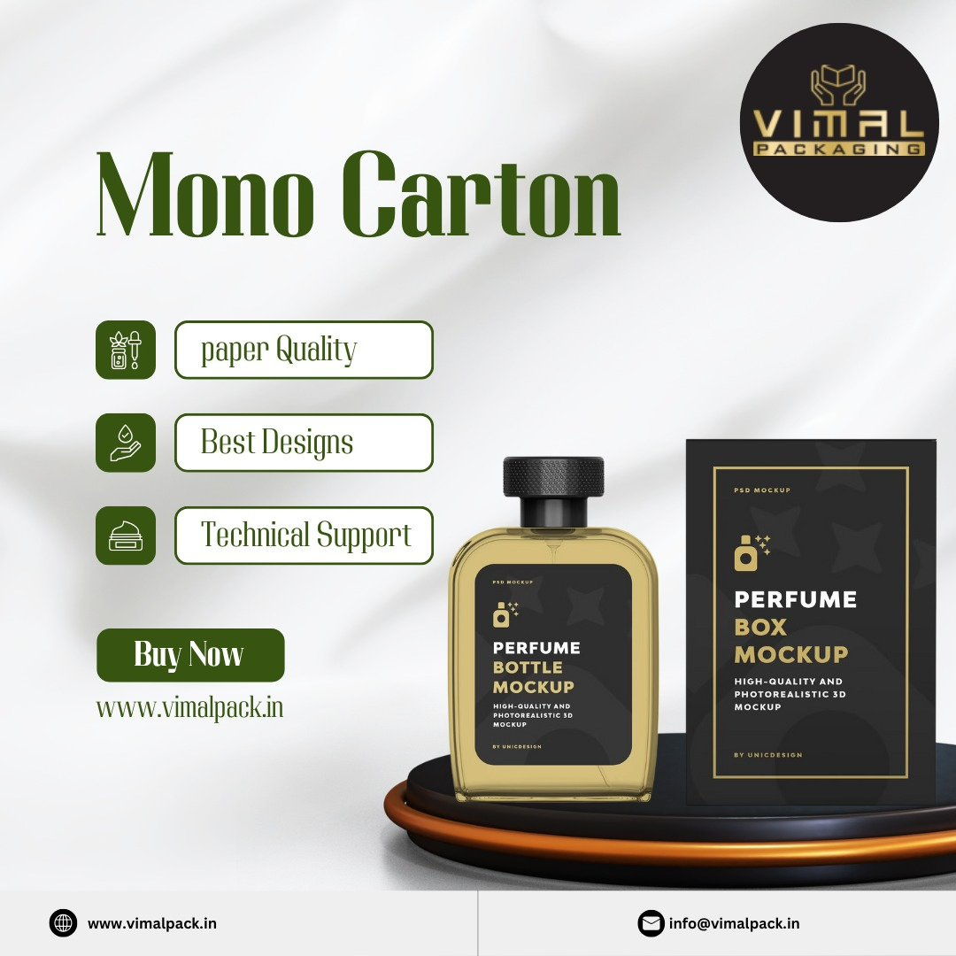

Slide 5



Slide 6
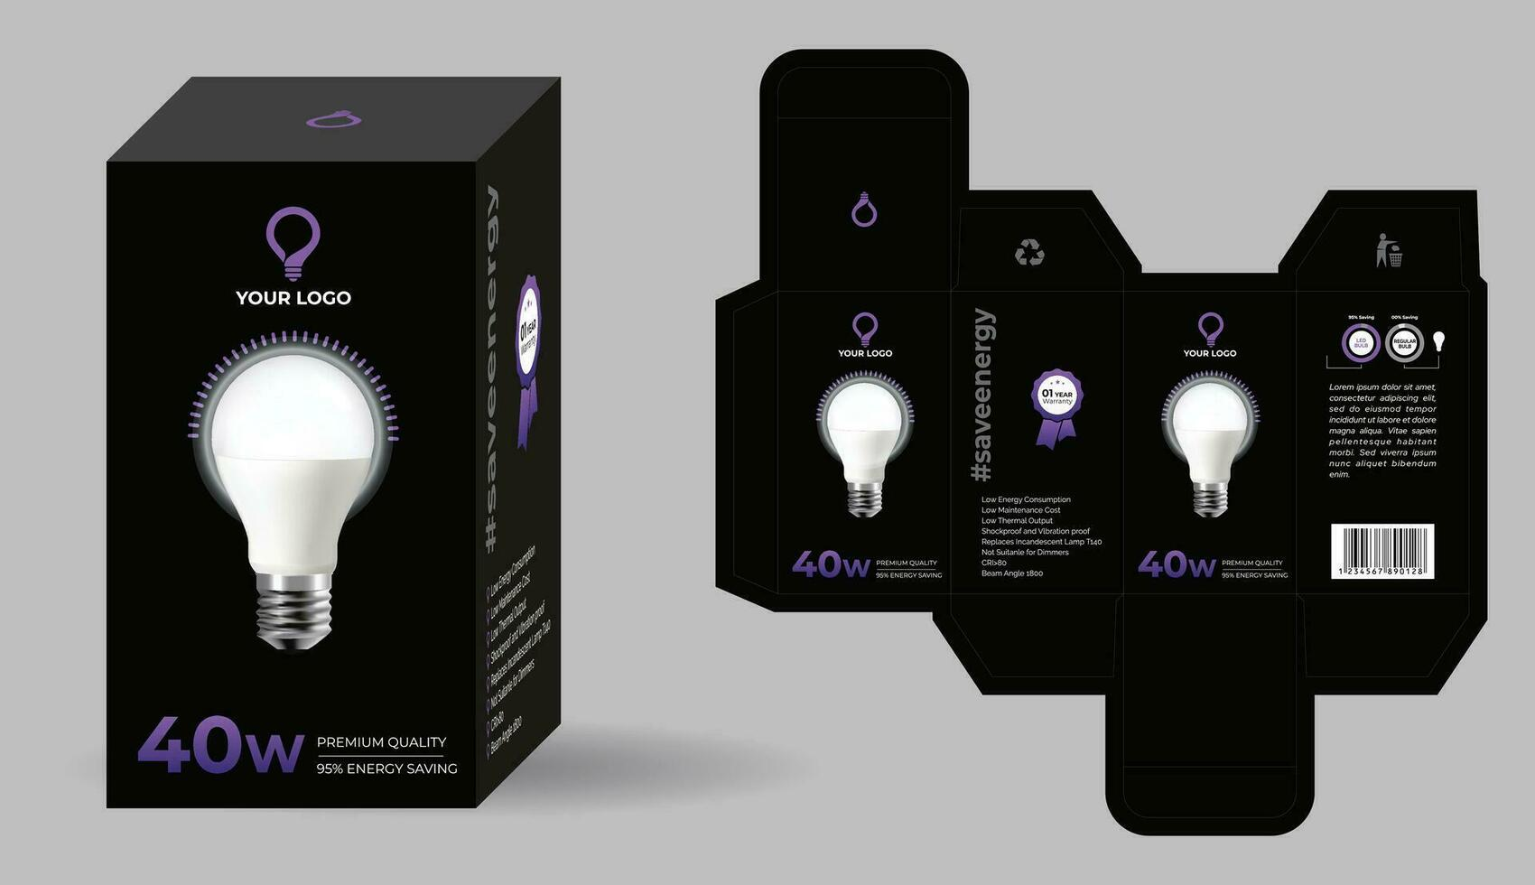
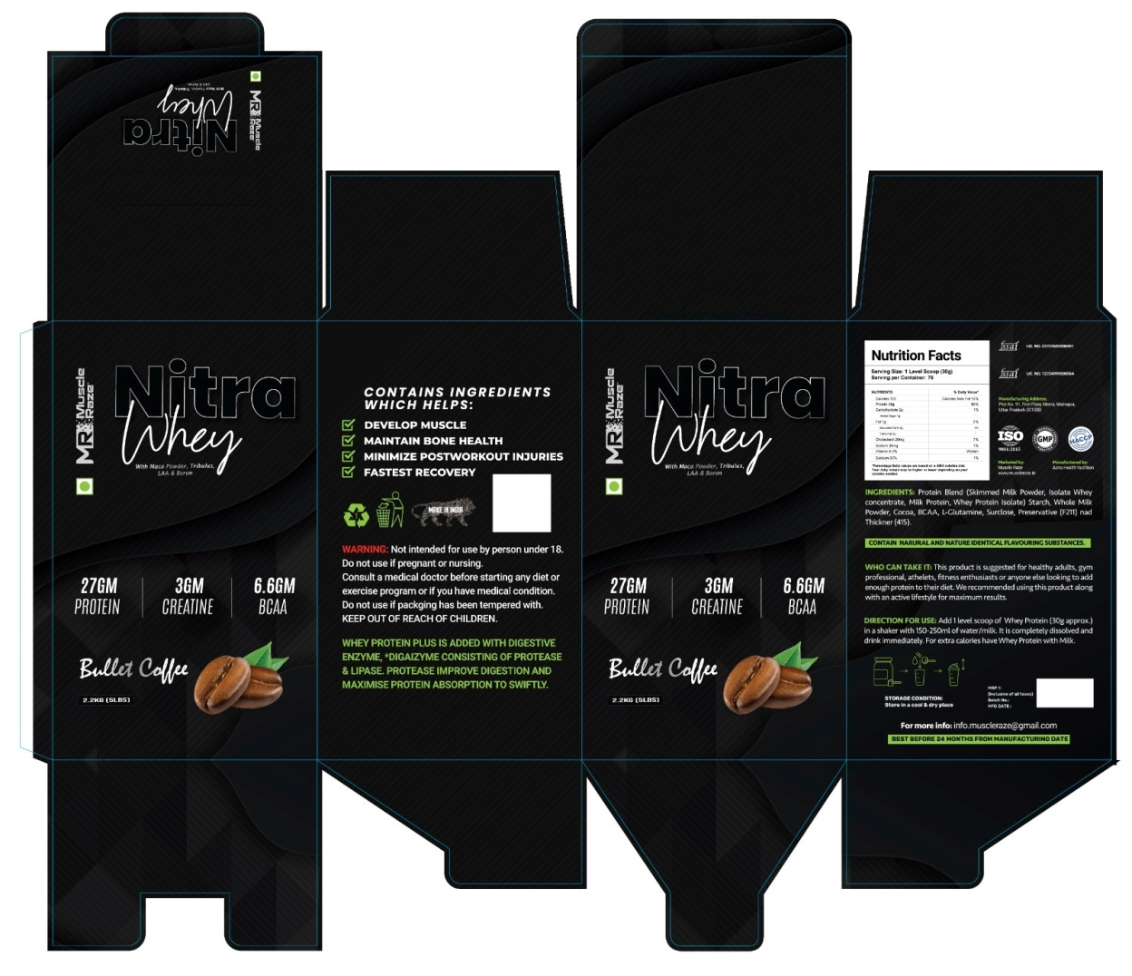
Packaging boxes

Slide 7
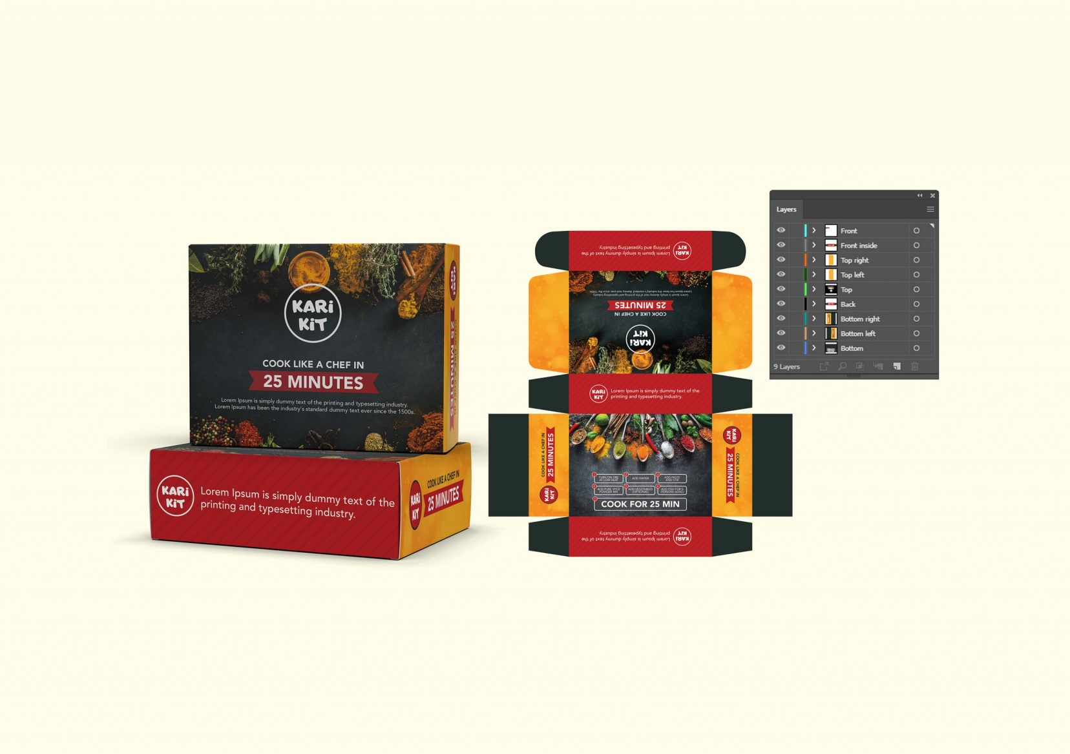
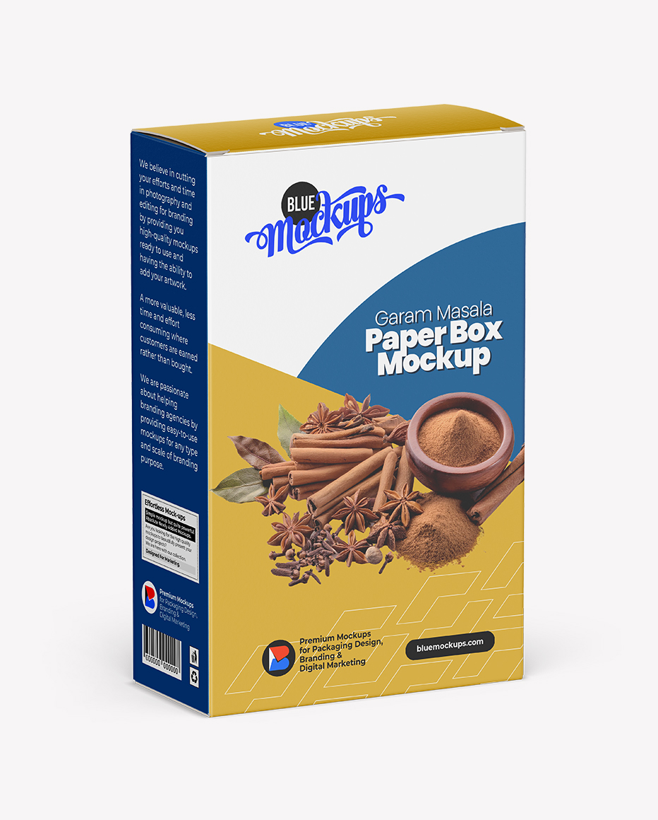
Packaging boxes

Slide 8
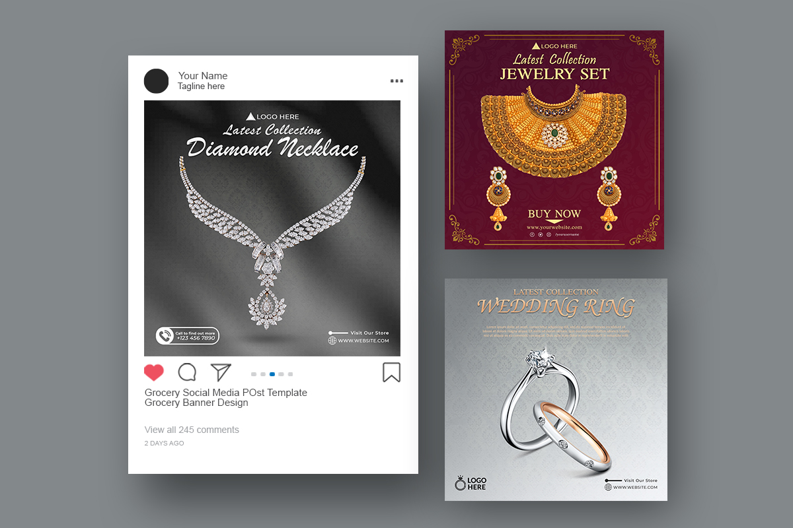
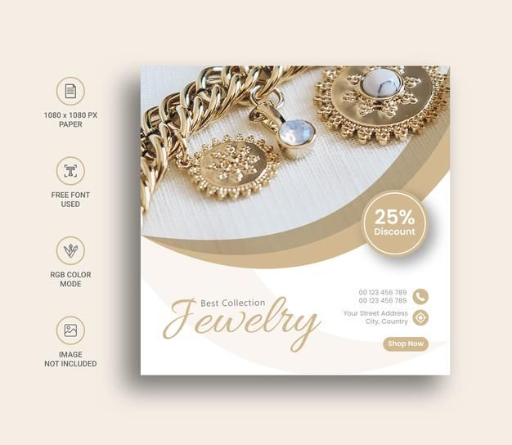
Jewelry Social MEDIA POST

